Slide 1



Statistical Analysis and Learning (SAL): Classification (ISL Ch4, part 2) Textbook: An Introduction to Statistical Learning (ISL)
Varun Rai
LBJ School of Public Affairs
The University of Texas at Austin
21st February 2018

Slide 2
Note on Material
Unless otherwise noted, all material in this presentation are from this course’s textbook, An Introduction to Statistical Learning (ISL)

Slide 3
Classification: Logistic Regression
Notes:
Review of material from last class

Slide 4
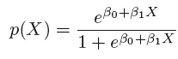
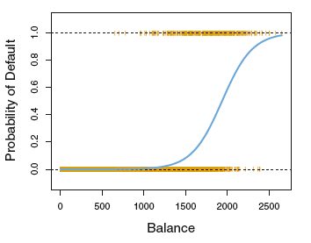
The Logistic Function

Slide 5
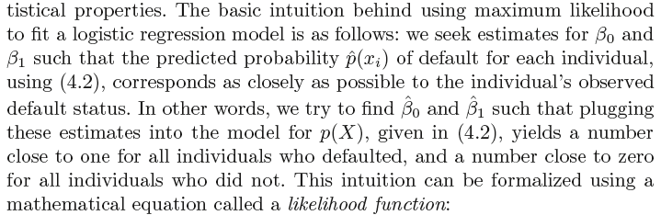
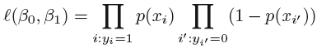
Estimating the Regression Coefficients: The Maximum Likelihood Method
Notes:
Useful resource:
https://towardsdatascience.com/probability-concepts-explained-maximum-likelihood-estimation-c7b4342fdbb1

Slide 6
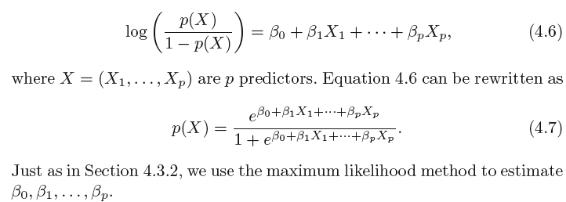
Multiple Logistic Regression, Binary Response

Slide 7
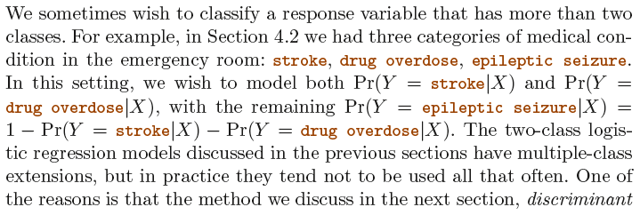
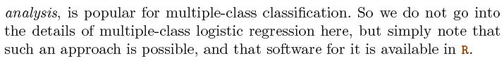
Logistic Regression with >2 Response Classes
Notes:
End review

Slide 8
Classification: Discriminant Analysis
Notes:
Begin session 1

Slide 9
Linear Discriminant Analysis (LDA)
Logistic regression involves directly modeling Pr(Y = k|X = x ) using the logistic function, given by (4.7) for the case of two response classes. In statistical jargon, we model the conditional distribution of the response Y , given the predictor(s) X .
We now consider an alternative and less direct approach to estimating these probabilities. In this alternative approach, we model the distribution of the predictors X separately in each of the response classes (i.e. given Y ), and then use Bayes’ theorem to flip these around into estimates for Pr(Y = k|X = x ).
When these distributions are assumed to be normal, it turns out that the model is very similar in form to logistic regression.

Slide 10
Why LDA?
When the classes are well-separated, the parameter estimates for the logistic regression model are surprisingly unstable. Linear discriminant analysis does not suffer from this problem.
If n is small and the distribution of the predictors X is approximately
normal in each of the classes, the linear discriminant model is again
more stable than the logistic regression model.
As mentioned in Section 4.3.5, linear discriminant analysis is popular
when we have more than two response classes.

Slide 11
Using Bayes’ Theorem for Classification Prior Probability
Let’s first redefine the problem:
Suppose that we wish to classify an observation into one of K classes, where K ≥ 2. In other words, the qualitative response variable Y can take on K possible distinct and unordered values.
Let π_{k} represent the overall or prior probability that a randomly chosen observation comes from the k^{th} class; this is the (prior) probability that a given observation is associated with the k^{th} category of the response variable Y .

Slide 12
Using Bayes’ Theorem for Classification Density Function
Let f_{k} (X ) ≡ Pr(X = x|Y = k ) denote the density function of X for an observation that comes from the k^{th} class.
In other words, f_{k} (x ) is relatively large if there is a high probability that an observation in the k^{th} class has X ≈ x , and f_{k} (x ) is small if it is very unlikely that an observation in the k^{th} class has X ≈ x.

Slide 13
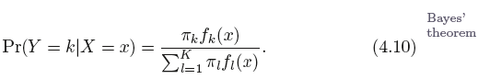
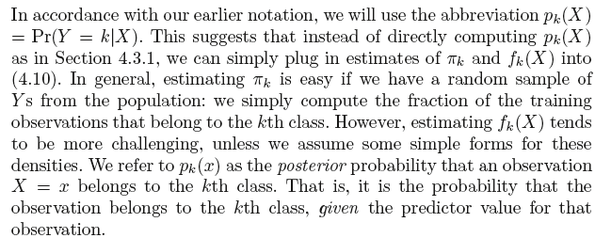
Using Bayes’ Theorem for Classification
prior probability
Remember Bayes Classifier?
The Bayes classifier, which classifies an observation to the class for which p_{k} (X ) is largest, has the lowest possible error rate out of all classifiers.
Therefore, if we can find a way to estimate f_{k} (X ), then we can develop a classifier that approximates the Bayes classifier.

Slide 14
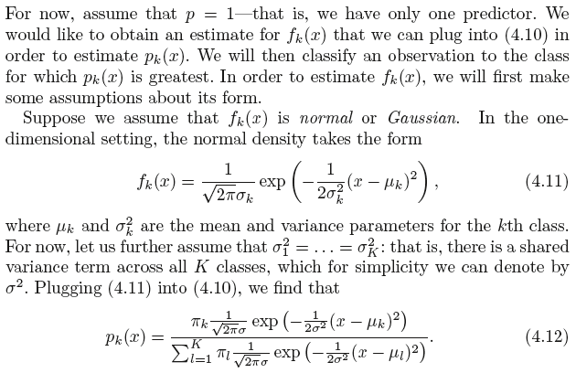
LDA for p = 1

Slide 15
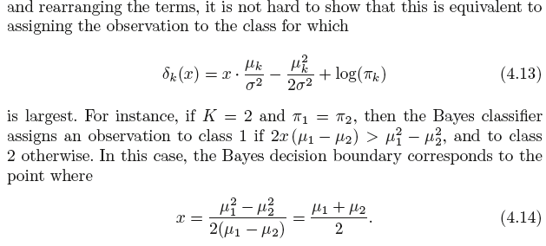
LDA for p = 1
The Bayes classifier involves assigning an observation X = x to the class for which (4.12) is largest. Taking the log of (4.12)
Notes:
For a given x, evaulate delta_k (eq. 4.13) for all k classes, and pick the class with highest delta_k.

Slide 16
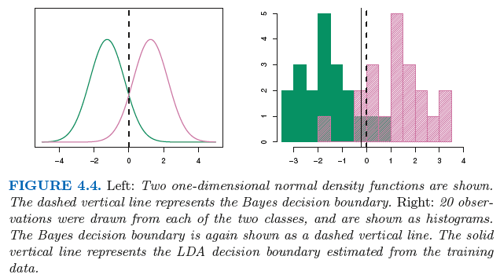
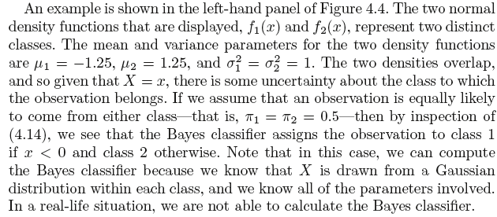
LDA for p = 1

Slide 17
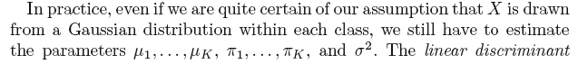
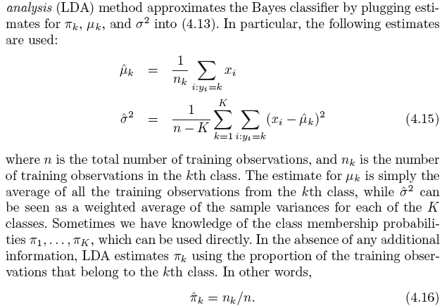
LDA for p = 1
How many parameters to estimate in LDA for a problem with K classes?
Notes:
k+k+1=2k+1

Slide 18
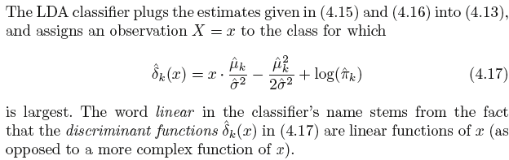
LDA for p = 1

Slide 19
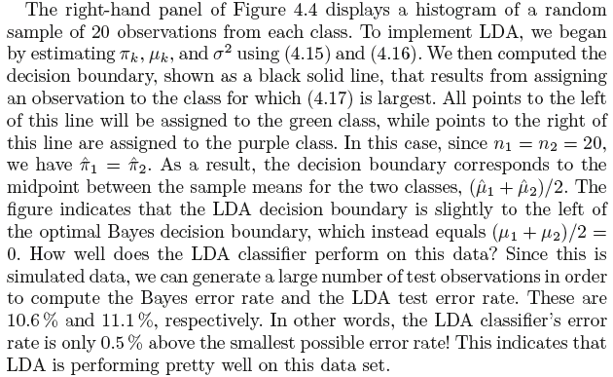
LDA for p = 1

Slide 20
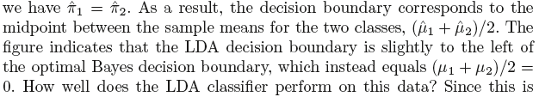
LDA for p = 1
why?

Slide 21
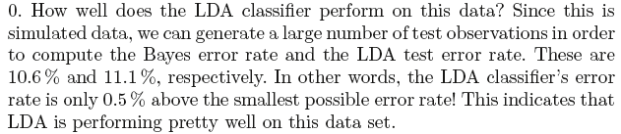
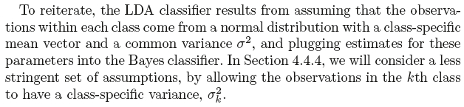
LDA for p = 1
Notes:
End session 1

Slide 22
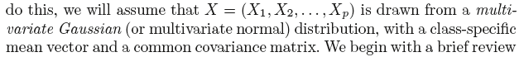
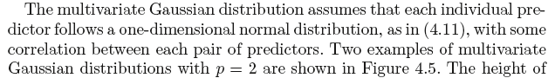
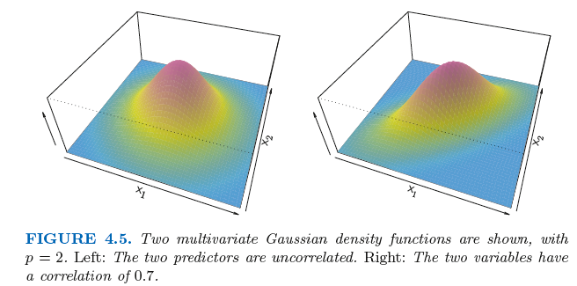
LDA for p > 1
Notes:
Begin session 2

Slide 23
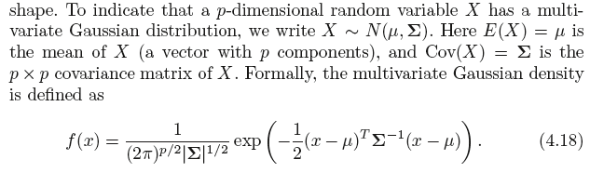
LDA for p > 1

Slide 24
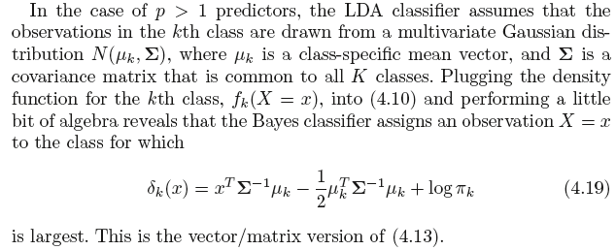
LDA for p > 1

Slide 25
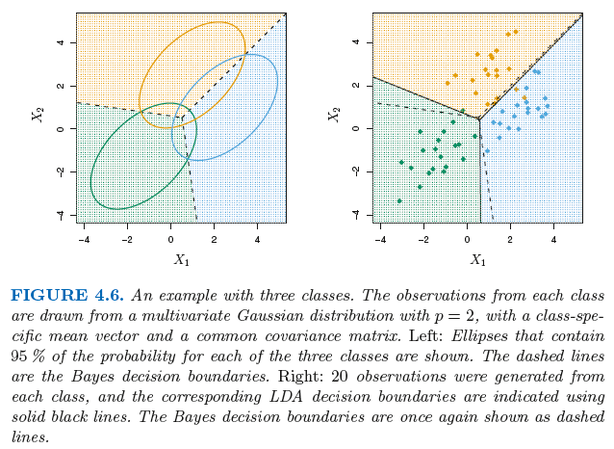
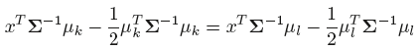
LDA for p > 1
Bayes Decision Boundaries:

Slide 26
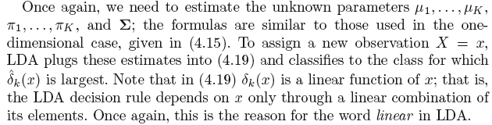
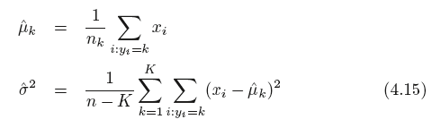
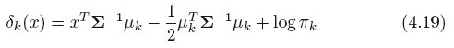
LDA for p > 1
How many parameters to estimate in LDA for a problem with K classes?
Notes:
p*k + k + p*(p+1)/2

Slide 27
LDA for p > 1

Slide 28
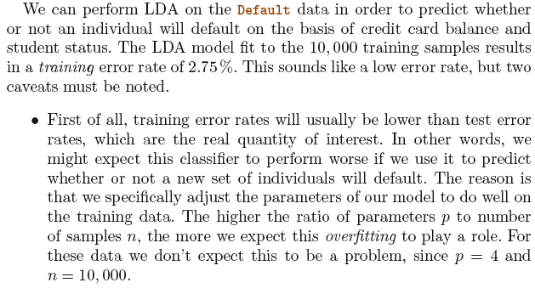
LDA on the Default Data

Slide 29
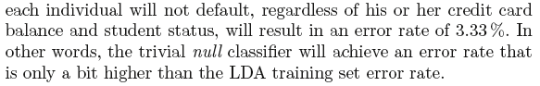
LDA on the Default Data, cntd.

Slide 30
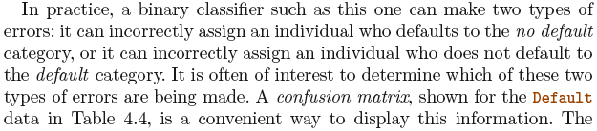
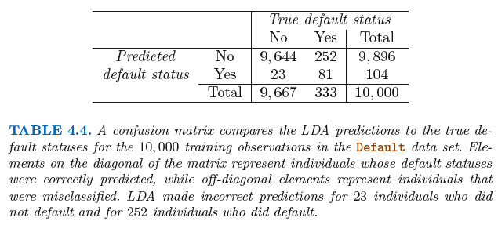
Confusion Matrix
False +ive
True +ive
Notes:
False +ive, because it’s classified by the model as a ‘default’ (i.e., +ive), but that classification is wrong (i.e., false). So ‘false’ relates to the actual (true) status and ‘+ive’ relates to the predicted status.

Slide 31
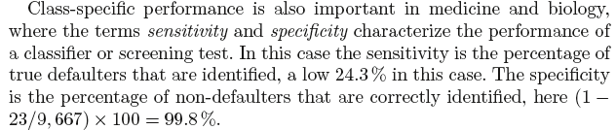
Sensitivity and Specificity of a Classifier

Slide 32
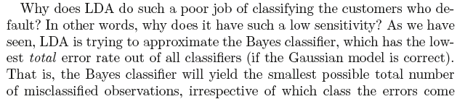
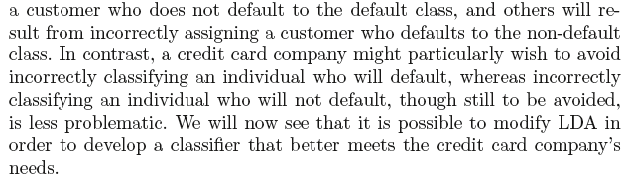
Modifying LDA for a Better Classifier

Slide 33
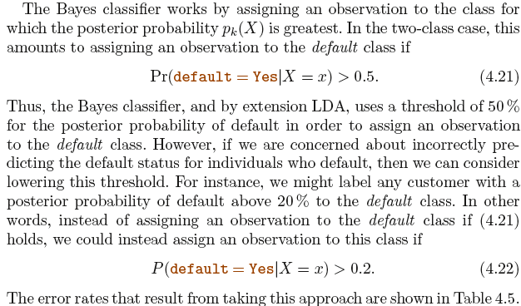
Modifying LDA, Lowering the Threshold

Slide 34
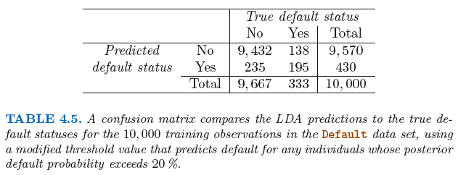
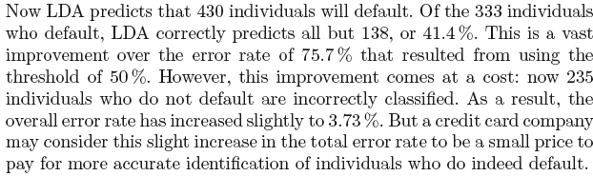
Lowering the Threshold
Notes:
Useful sources:
1. https://www.coursera.org/learn/ml-foundations/lecture/pcbUq/false-positives-false-negatives-and-confusion-matrices
2. http://www.dataschool.io/simple-guide-to-confusion-matrix-terminology/
Accuracy: Overall, how often is the classifier correct?
(TP+TN)/total = (100+50)/165 = 0.91
Misclassification Rate: Overall, how often is it wrong?
(FP+FN)/total = (10+5)/165 = 0.09
equivalent to 1 minus Accuracy
also known as "Error Rate"
True Positive Rate: When it's actually yes, how often does it predict yes?
TP/actual yes = 100/105 = 0.95
also known as "Sensitivity" or "Recall"
False Positive Rate: When it's actually no, how often does it predict yes?
FP/actual no = 10/60 = 0.17
Specificity: When it's actually no, how often does it predict no?
TN/actual no = 50/60 = 0.83
equivalent to 1 minus False Positive Rate
Precision: When it predicts yes, how often is it correct?
TP/predicted yes = 100/110 = 0.91
Prevalence: How often does the yes condition actually occur in our sample?
actual yes/total = 105/165 = 0.64

Slide 35
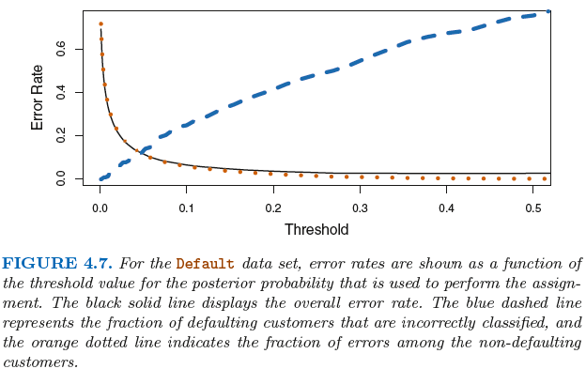
Lowering the Threshold: Tradeoffs in Errors

Slide 36
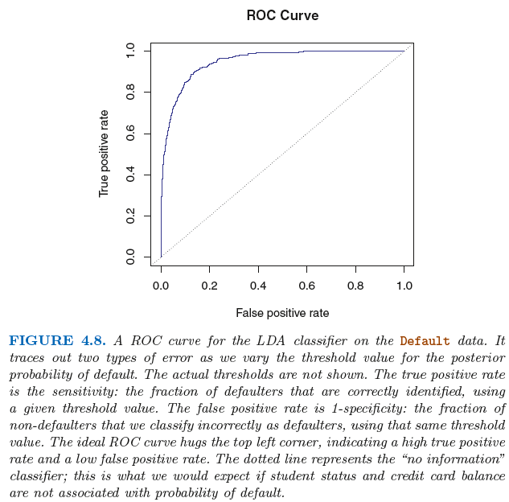
The ROC Curve (Receiver Operating Characteristics)
The overall performance of a classifier, summarized over all possible thresholds, is given by the area under the (ROC) curve (AUC). An ideal ROC curve will hug the top left corner, so the larger area under the (ROC) curve the AUC the better the classifier.
Notes:
End session 2

Slide 37
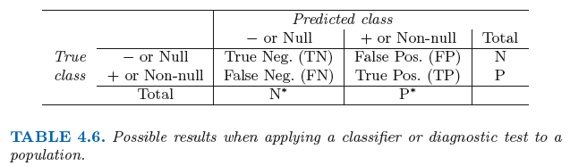
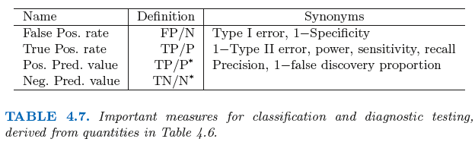
Recall and Precision, etc.

Slide 38
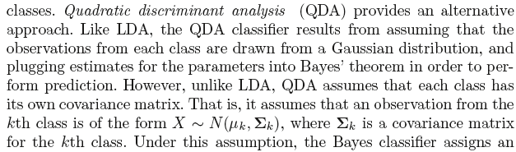
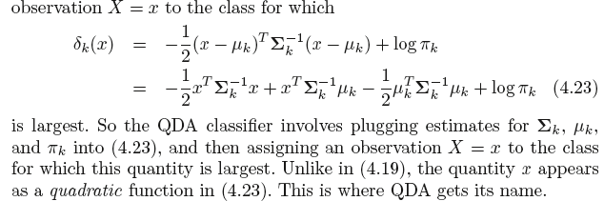
Quadratic Discriminant Analysis (QDA)
Notes:
Begin session 3

Slide 39
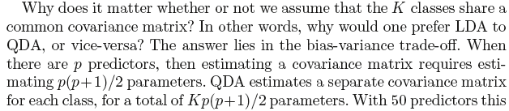
Why Assume that Class Covariance is the Same or Not? That is, Why QDA over LDA?

Slide 40
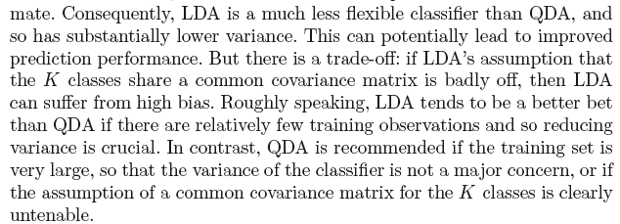
Why Assume that Class Covariance is the Same or Not? That is, Why QDA over LDA?

Slide 41
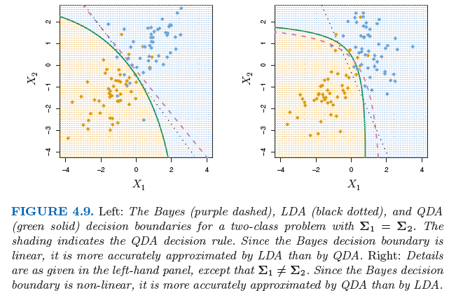
Why Assume that Class Covariance is the Same or Not? That is, Why QDA over LDA?

Slide 42
Notes:
A Comparison of Classification Models
both logistic regression and LDA produce linear decision boundaries. The only difference
between the two approaches lies in the fact that β0 and β1 are estimated
using maximum likelihood, whereas c0 and c1 are computed using the estimated
mean and variance from a normal distribution. This same connection
between LDA and logistic regression also holds for multidimensional data
with p > 1.
Since logistic regression and LDA differ only in their fitting procedures,
one might expect the two approaches to give similar results. This is often,
but not always, the case. LDA assumes that the observations are drawn
from a Gaussian distribution with a common covariance matrix in each
class, and so can provide some improvements over logistic regression when
this assumption approximately holds. Conversely, logistic regression can
outperform LDA if these Gaussian assumptions are not met.
Recall from Chapter 2 that KNN takes a completely different approach
from the classifiers seen in this chapter. In order to make a prediction for
an observation X = x , the K training observations that are closest to x are
identified. Then X is assigned to the class to which the plurality of these
observations belong. Hence KNN is a completely non-parametric approach:
no assumptions are made about the shape of the decision boundary. Therefore,
we can expect this approach to dominate LDA and logistic regression
when the decision boundary is highly non-linear. On the other hand, KNN
does not tell us which predictors are important;

Slide 43
Problem Set: Read and Summarize §4.5, “A Comparison of Classification Models”

Slide 44
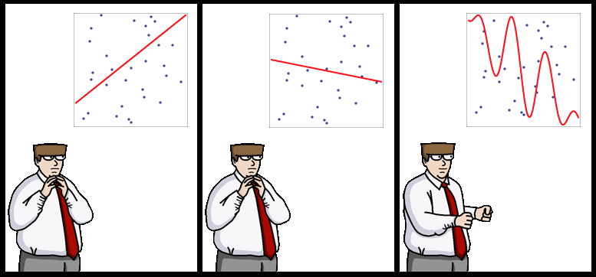
End of Lecture #6
Source: http://yaroslavvb.blogspot.com/

